Slide 1
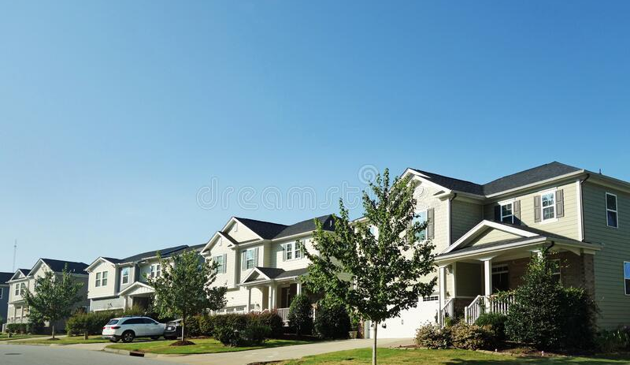
Real Estate Market Predictions
Real Estate Market Predictions:
A look at North Carolina
Real Estate Market Predictions:
A look at North Carolina
A look at NC real estate

Slide 2
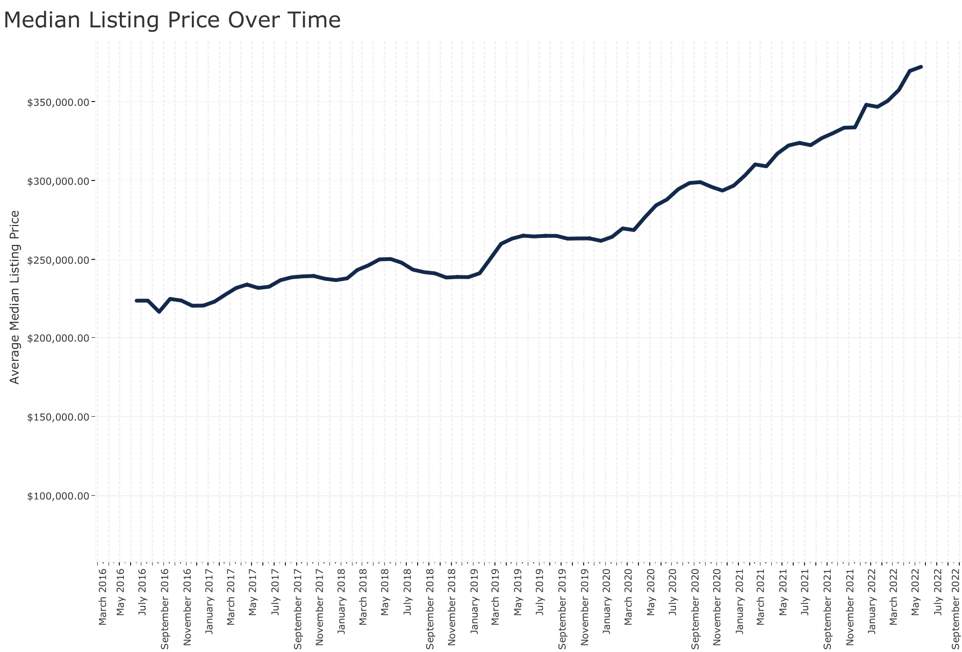
Why real estate? Why now?
Notes:
Covid shook up a lot of things and Real Estate was definitely one of them. The pandemic brought about a low supply of housing with a high demand. This has driven drastic price increases. As mortgage rates increase, will the housing market continue to see such growth? Will prices level off? What are the factors that ultimately affect the price we pay for our homes.

Slide 3
Data Sources
the RDC Core Metrics by Zipcode Inventory of historical data and the RDC Inventory Hotness Metrics Zip History from Realtor.com
zipcode latitude and longitude data sourced from Github repo
Mortgage rates from FreddieMac
NC crime statistics from NCSBI.gov
NC school data and park data from The National Neighborhood Data Archive (NaNDA)

Slide 4
Questions we hope to answer:
What community features most affect house pricing? Crime statistics, area schools, proximity to parks and recreation, population demographics?
Will we continue to see exponential growth in house prices with rising interest rates?
Can we use these features to accurately predict the sale price of Lindsey’s house?

Slide 5







Notes:
Postrgre SQL for Joins/ Python Jupyter for Cleaning/Joins/ Machine Learning and Excel website into table and pdf in to table. Bit.io for our database that we connected our information to.

Slide 6
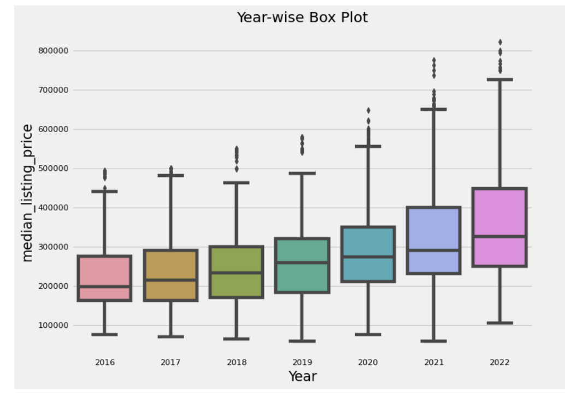
Data Exploration
Notes:
Our original datasets focused on features such median listing price (our target), the price change in percent over time, average days on the market, number of active and new listings by county, number of homes with a price increase or price decrease (also by county), median square feet. This information ranged from 2016 to 2022. Our initial exploration showed the growth in the median listing price year over year, and while there were obvious outliers most of the data seemed fairly consistent.

Slide 7
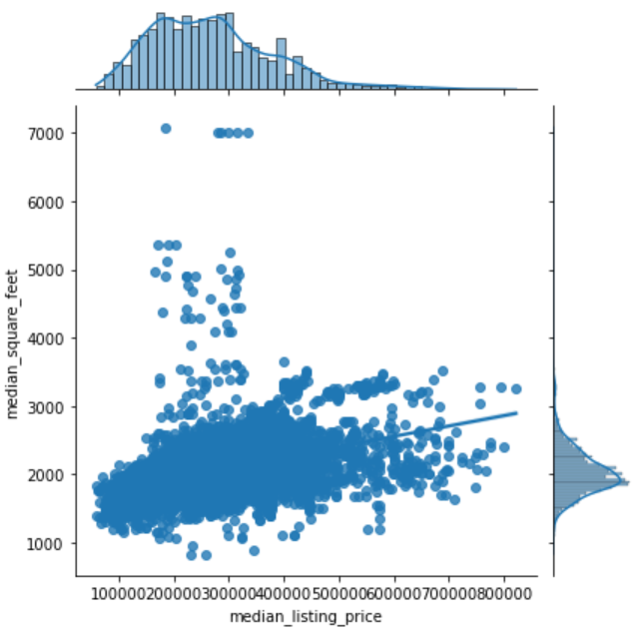
Data Exploration
Notes:
We decided our data set was too limited and we needed to introduce more variability with additional features. We then sourced additional data such as crime statistics, number of parks and number of schools by county. Unfortunately, school and crime data take time to publish so we were not able to source the most recent years resulting in a smaller data set than we originally intended.

Slide 8
The ETL process
1- Extract
Extract data from multiple sources, ensuring it has all the information necessary and limited null values.
2 - Transform
Utilize pandas to remove null values and drop unnecessary or repetitive features, merge data sets and create multiple data frames.
3 - Load
Create an Entity Relational Diagram to reference when loading final data to Postgress SQL with pgAdmin. Create final joins.
Notes:
We extracted data from several sources. This caused a lot of issues when trying to join and merge the various datasets. Our data required that we reformat dates, change column names and data types to be cohesive between tables. Our various data sets also used different geographical boundaries such as county, ZIP code, and ZCTAs (ZIP code tabulation areas). These are generalized areal representations derived from the USPS ZIP codes and used by the US Census Bureau. Some of the data such as the crime statistics and interest rates were created in excel based off pdf files and website tables.
We utilized pandas to remove null values, drop unnecessary columns and repetitive information. We also utlized pandas for some joins. We then jumped to PostgressSQL with pgAdmin.

Slide 9
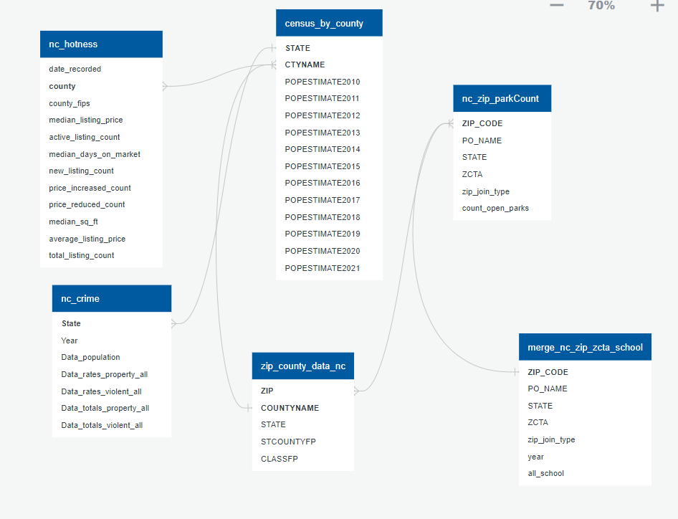
ERD
Notes:
The entity relational diagram shows some of these discrepancies. In the end we spent a lot time jumping between both pandas and SQL to create one final table to use in our machine learning.

Slide 10
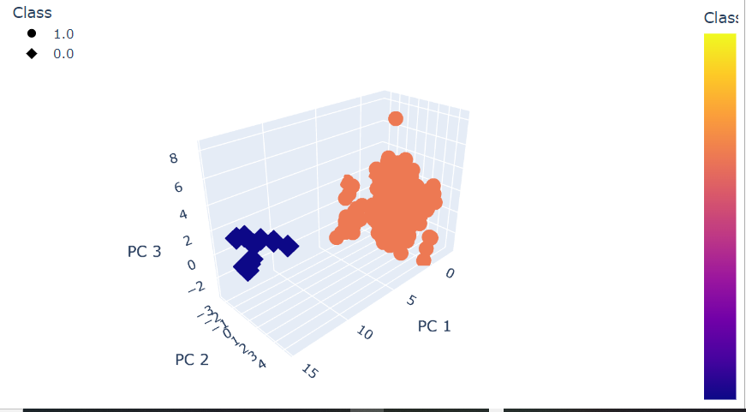
K-means Clustering
Notes:
In the early stage, To see if the median listing price is increasing/decreasing influenced by the community features Created clusters using K-means in an effort to group similar data features and discover any underlying patterns. We tested 3 clusters to explore any further groupings within the larger orange class, but determined two clusters was most accurate and verified with the elbow curve.

Slide 11
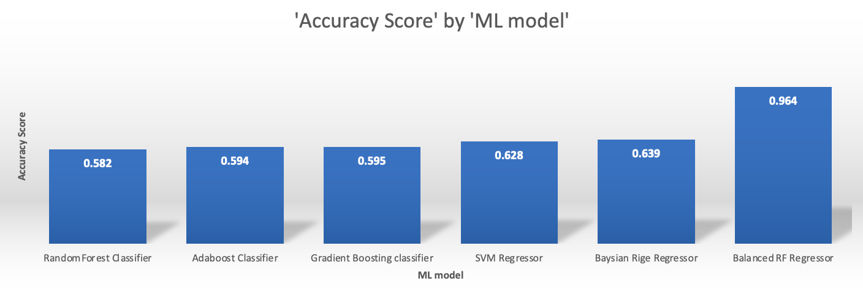
Data Analysis
Notes:
Next we tested various ensemble classifiers such as Random Forest Classifier, AdaBoost Classifier, Gradient Boosting Classifier to see if the median listing price is increasing/decreasing influenced by the community features. For the classifier models, we needed to create a predictive class. This was done by creating an increase/decrease column based on the percent change of the median listing price. Our accuracy scores were underwhelming. We utilized hypertuning on all three of the classifier models, but did not see the increase in accuracy we were looking for. We then moved on to regression models, testing several regressor models, setting the median listing price as the predictive field.

Slide 12
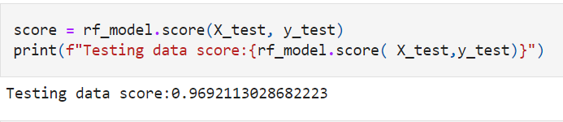
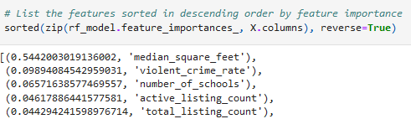
Data Analysis: Balanced Random Forest Regressor
Notes:
Our highest accuracy score was achieved with the Balanced Random Forest Regressor. Hypertuning with 144 fits; it did not yield noticeable score improvement. The original accuracy score was 96.9%. The feature importance as it stands places the nontraditional features: violent crime and number of schools, in the top five. Future exploration of machine learning models for fit will be necessary to validate this relationship.

Slide 13
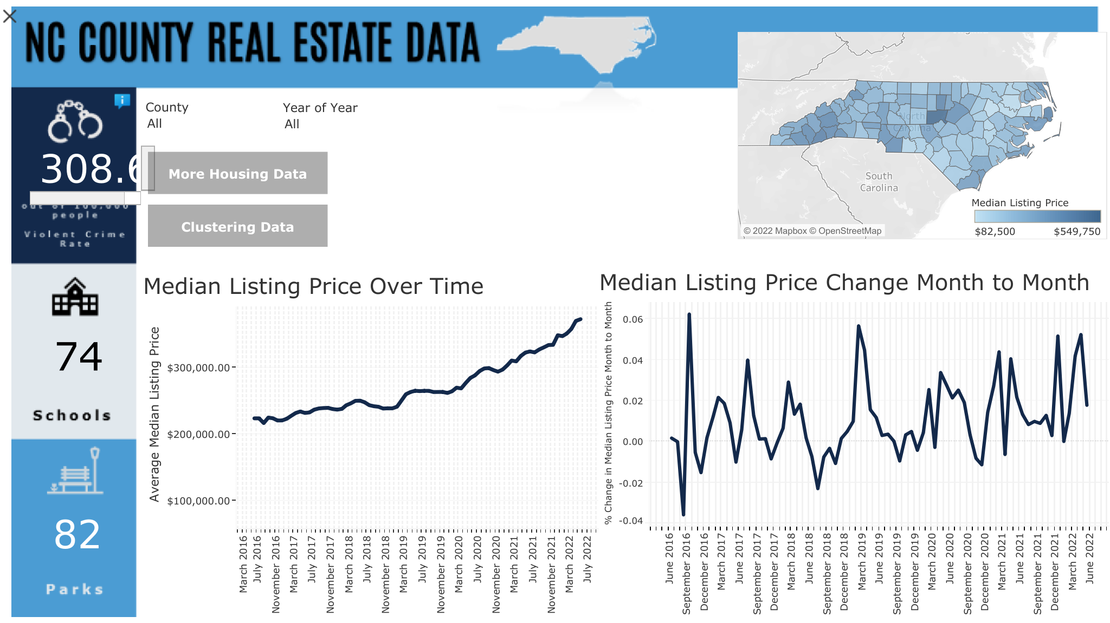
Dashboard
NC County Real Estate Data
-

Slide 14
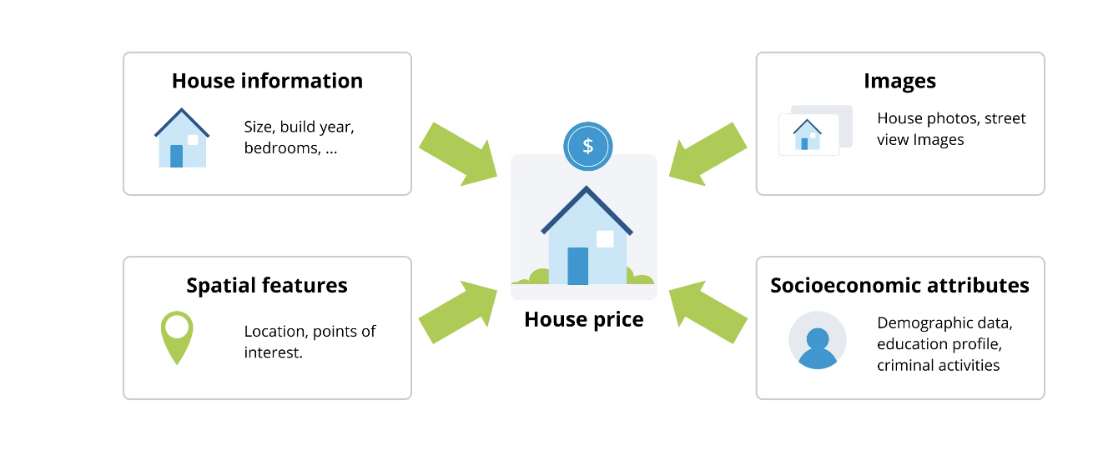
Conclusions
Notes:
With naive knowledge in the machine learning world and the limited dataset, we concluded that the change in accuracy score due to some of the hypertune parameters is adequate in predicting our target variable median listing price.
From this project, we learnt that it is important to design an approach that is fed with data from various sources. Only then does it makes sense to apply state-of-the-art Machine Learning techniques to real estate questions, such as median listing price. The combination of traditional and nontraditional data might yield a more accurate estimation.
For Future analysis, we want to Source more robust community data using smaller geographical areas
Source school ratings rather than number of schools
Fill in missing crime data for later years
Source other non-traditional data such as: distance to grocery stores, area tax rates, availability of public transportation,population density, proximity to the recreational areas,accessibility of the area (number of roads, condition of the roads)
Experiment with more Regressor models and multiple hypertune parameters try basic neural networks models and Deep learning.

